Slide 1
Chapter 1- Introduction and Software Processes

Slide 2
Topics covered
Basic definition
Role of Management in Software Development
Software Products
Essential attributes of good software
Challenges for Software Engineering Practices
Software Engineering Diversity
Software Life Cycle
Software Process Model and its Types

Slide 3
1.1 Basic Definition
What is software?
Computer programs and associated documentation. Software products may be developed for a particular customer or may be developed for a general market.
What is software engineering?
Software engineering is an engineering discipline that is concerned with all aspects of software production from initial conception to operation and maintenance.
The IEEE [IEE17] has developed the following definition for software engineering:
The application of a systematic, disciplined, quantifiable approach to the development, operation, and maintenance of software; that is, the application of engineering to software.

Slide 4
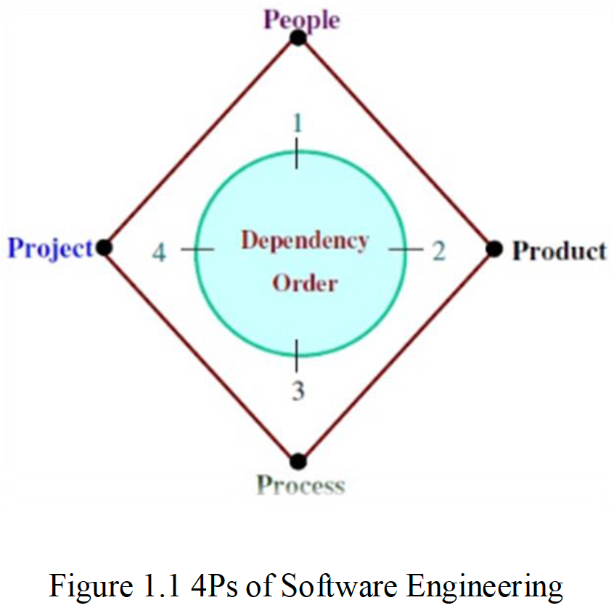
1.2 Role of Management in Software Development
Factor | Role
People | Software development requires good managers. The manager who can understand the psychology of the people and provide good leadership. After having a good manager, project is in safe hands. It is the responsibility of a manager to manage, motivate, encourage, guide and control the people of his/her team.
Product | What is delivered to the customer, is called a product. It may include source code, specification document, manuals, documentation etc. Basically, it is nothing but a set of deliverables only.
Process | Process is the way in which we produce software. It is the collection of activities that leads to (a part of) a product. An efficient process is required to produce good quality products. If the process is weak, the end product will undoubtedly suffer, but an obsessive over reliance on process is also dangerous.
Project | A proper planning is required to monitor the status of development and to control the complexity. Most of the projects are coming late with cost overruns of more than 100%. In order to manage a successful project, we must understand what can go wrong and how to do it wright.

Slide 5
1.3 Software products
Generic products
Stand-alone systems that are marketed and sold to any customer who wishes to buy them.
Examples – PC software such as graphics programs, project management tools; CAD software; software for specific markets such as appointments systems for dentists.
Customized products
Software that is commissioned by a specific customer to meet their own needs.
Examples – embedded control systems, air traffic control software, traffic monitoring systems.

Slide 6
1.4 Essential attributes of good software
Product characteristic | Description
Maintainability | Software should be written in such a way so that it can evolve to meet the changing needs of customers. This is a critical attribute because software change is an inevitable requirement of a changing business environment.
Dependability and security | Software dependability includes a range of characteristics including reliability, security and safety. Dependable software should not cause physical or economic damage in the event of system failure. Malicious users should not be able to access or damage the system.
Efficiency | Software should not make wasteful use of system resources such as memory and processor cycles. Efficiency therefore includes responsiveness, processing time, memory utilisation, etc.
Acceptability | Software must be acceptable to the type of users for which it is designed. This means that it must be understandable, usable and compatible with other systems that they use.

Slide 7
1.5 Challenges for Software Engineering Practices
Heterogeneity
Increasingly, systems are required to operate as distributed systems across networks that include different types of computer and mobile devices.
Business and social change
Business and society are changing incredibly quickly as emerging economies develop and new technologies become available. They need to be able to change their existing software and to rapidly develop new software.
Security and trust
As software is intertwined with all aspects of our lives, it is essential that we can trust that software.

Slide 8
1.6 Software Engineering Diversity
There are many different types of software system and there is no universal set of software techniques that is applicable to all of these. Rather, a diverse set of software engineering methods and tools has evolved.
The software engineering methods and tools used depend on the type of application being developed, the requirements of the customer and the background of the development team. There are many different types of application, including:
1. Stand-alone applications 5. Entertainment systems
2. Interactive transaction-based applications 6. Systems for modeling and simulation
3. Embedded control systems 7. Data collection systems
4. Batch processing systems 8. Systems of systems

Slide 9
Software Engineering Diversity : Application types
Stand-alone applications
These are application systems that run on a local computer, such as a PC. They include all necessary functionality and do not need to be connected to a network.
Interactive transaction-based applications
Applications that execute on a remote computer and are accessed by users from their own PCs or terminals. These include web applications such as e-commerce applications.
Embedded control systems
These are software control systems that control and manage hardware devices. Numerically, there are probably more embedded systems than any other type of system.
Batch processing systems
These are business systems that are designed to process data in large batches. They process large numbers of individual inputs to create corresponding outputs.

Slide 10
Software Engineering Diversity : Application types
Entertainment systems
These are systems that are primarily for personal use and which are intended to entertain the user.
Systems for modeling and simulation
These are systems that are developed by scientists and engineers to model physical processes or situations, which include many, separate, interacting objects.
Data collection systems
These are systems that collect data from their environment using a set of sensors and send that data to other systems for processing.
Systems of systems
These are systems that are composed of a number of other software systems.

Slide 11
1.7 Software Life cycle
The goal of Software Engineering is to provide models and processes that lead to the production of well-documented maintainable software in a manner that is predictable.
In the IEEE standard Glossary of Software Engineering Terminology, the software life cycle is: The period of time that starts when a software product is conceived and ends when the product is no longer available for use.
The software life cycle typically includes a requirement phase, design phase, implementation phase, test phase, installation and check out phase, operation and maintenance phase, and sometimes retirement phase”.
These activities involve the development of software from scratch until it is delivered to customers.

Slide 12
1.8 Software Process Model
Software process is defined as the structured set of activities that are required to develop the software system.
Many different software processes but all involve:
Specification – defining what the system should do;
Design and implementation – defining the organization of the system and implementing the system;
Validation – checking that it does what the customer wants;
Evolution – changing the system in response to changing customer needs.
A software process model is an abstract representation of a process. It presents a description of a process from some particular perspective.

Slide 13
1.9 Types of Software process models
There are many types of software process models that development teams use across different industries. Here are some examples of typical software process models you can use to outline your development process:
The waterfall model
Incremental development model
Reuse-oriented Model
Boehm’s Spiral Model
Agile methods

Slide 14
1.9.1The waterfall model
Waterfall model is the earliest software development life cycle (SDLC) approach that was used for software development. It is also referred to as a linear-sequential life cycle model. It is very simple to understand and use.
In a waterfall model, each phase must be completed before the next phase can begin and there is no overlapping in the phases. All phases are cascaded to each other in which progress is seen as flowing steadily downwards (like a waterfall) through the phases.
In Waterfall model, typically, the outcome of one phase acts as the input for the next phase sequentially. The next phase is started only after the defined set of goals are achieved for previous phase and it is signed off, so the name "Waterfall Model".

Slide 15
The waterfall model
Figure 1.2: Waterfall Model

Slide 16
Waterfall model phases
Phase | Description
Requirement Gathering and analysis | All possible requirements of the system to be developed are captured in this phase and documented in a requirement specification doc.
System Design | The requirement specifications from first phase are studied in this phase and system design is prepared. System Design helps in specifying hardware and system requirements and also helps in defining overall system architecture.
Implementation | With inputs from system design, the system is first developed in small programs called units, which are integrated (وحدات متكاملة) in the next phase. Each unit is developed and tested for its functionality which is referred to as Unit Testing.
Integration and Testing | All the units developed in the implementation phase are integrated into a system after testing of each unit. Post integration the entire system is tested for any faults and failures.
Deployment of system | Once the functional and non-functional testing is done, the product is deployed in the customer environment (تثبيت البرنامج للاستخدام) or released into the market.
Maintenance | There are some issues which come up in the client environment. To fix those issues patches are released. Also to enhance the product some better versions are released. Maintenance is done to deliver these changes in the customer environment.

Slide 17
1.9.2 Incremental Development Model
Incremental model uses the linear sequential approach with the iterative nature of prototyping. Incremental development is based on the idea of developing an initial implementation, delivering it to user for feedback and improving it through several versions of product releases until an acceptable system is developed.
In incremental model the whole requirement is divided into various builds.
During each iteration, the development module goes through the requirements, design, implementation and testing phase.
Each subsequent release of the module adds function to the previous release. The process continues till the complete system is ready as per the requirement.
The key to use of incremental development model successfully is rigorous validation of requirements, and verification of each version of the software against the requirements.

Slide 18
Incremental Development Model
Figure 1.3: Incremental Development Model

Slide 19
1.9.3 Reuse-oriented Model
The reuse-oriented development is where they reuse programming or software in previous projects or existing software components.
Reuse-oriented development is based on systematic reuse where systems are integrated from existing components.
This development can reduce the overall cost of software development and it can also save time because each phase of the process builds on the previous phase which has already been refined.
Figure1.4: Reuse-oriented software engineering

Slide 20
Reuse-oriented Model phases
Requirement Specification: All possible requirements of the system to be developed are captured in this phase.
2. Component Analysis: According to given requirement, component is selected to implement that requirement specification. That is not possible the selected component provide the complete functionality, but that is possible the component used provide some of the functionality required.
3. Requirement Modification: Information about component that is selected during component analysis is used to analysis requirement specification. Requirements are modified according to available components. Requirement modification is critical then component analysis activity is reused to find relative solution.
4. System design with reuse: During this stage the design of the system is build. Designer must consider the reused component and organize the framework. If reused component is not available then new software is develop.
5. Development and Integration: Components are integrated to develop new software. Integration in this model is part of development rather than separate activity.

Slide 21
1.9.4 Boehm’s Spiral Model
A risk-driven software process framework (the spiral model) was proposed by Boehm.
Process is represented as a spiral rather than as a sequence of activities with some backtracking from one activity to another.
Each loop in the spiral represents a phase in the process.
No fixed phases such as specification or design - loops in the spiral are chosen depending on what is required.
Risks are explicitly assessed and resolved throughout the process.

Slide 22
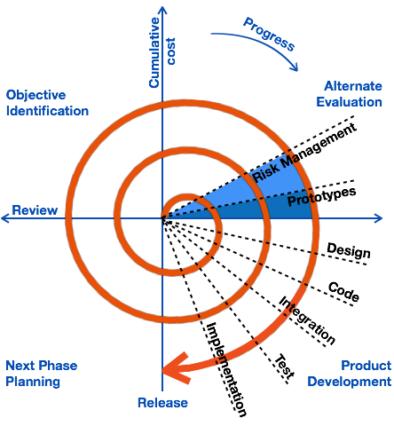
Boehm’s spiral model of the software process

Slide 23
Explanation of Spiral Model Activities
Activity | Description
Objective Identification | Requirements are gathered from the customers and the objectives are identified, elaborated, and analyzed. Project risks are identified. Alternative strategies, depending on these risks, may be planned.
Alternate Evaluation | In this quadrant, all the proposed solutions are analyzed and any potential risk is identified, analyzed, and resolved. The Prototype is built for the best possible solution.
Product development | The identified features are developed and verified through testing. At the end of the stage, the next version of the software is available.
Next Phase Planning | The project is reviewed and a decision made whether to continue with a further loop of the spiral. If it is decided to continue, plans are drawn up for the next phase of the project.

Slide 24
1.9.5 Agile methods
Agile model is a combination of iterative and incremental process models with focus on process adaptability and customer satisfaction by rapid delivery of working software product.
Agile Methods break the product into small incremental builds. These builds are provided in iterations. At the end of each iteration a working product is displayed to the customer.
In Agile development less time is spent on planning and more focus on the features need to be developed. There is feature driven development and the team adapts to the changing product requirements dynamically. The product is tested very frequently, through the release iterations, minimizing the risk of any major failures in future.
.

Slide 25
Agile methods
Figure 2.5: Graphical Illustration of the Agile Methods

Slide 26
1.9.6 Comparison of Different Software Process Models
Process model | Approach | Advantages | Disadvantages | When to Apply
Waterfall | Linear sequential | Clear documentation, easy to manage | Inflexible, limited feedback, high risk | Simple, small projects with clear requirements
Incremental | Linear Sequential with Iterative | Easier to test and debug, more flexible, simple to manage risk. | Can be time-consuming, expensive, requires a high level of collaboration | Projects with changing requirements
Reuse-oriented | Reuse-based | Reduce total cost, low risk factor, save lots of time and effort. | Requires well-defined components, may not fit all projects | Projects that necessitate a high level of flexibility, scalability, maintainability
Spiral | Iterative, risk-driven | Highlights risk management, flexible, adaptive | Time-consuming, can be expensive | Large, complex, high-risk projects
Agile | Iterative | Flexible, adaptive, continuous feedback | Requires active user involvement, can be chaotic | Complex projects with fluctuating requirements

Slide 27
Key points
Software engineering is an engineering discipline that is concerned with all aspects of software production.
Essential software product attributes are maintainability, dependability and security, efficiency and acceptability.
The high-level activities of specification, development, validation and evolution are part of all software processes.
There are many different types of system and each requires appropriate software engineering tools and techniques for their development.
Software processes are the activities involved in producing a software system. Software process models are abstract representations of these processes.

Slide 28
Key points
General process models describe the organization of software processes. Examples of these general models include the ‘waterfall’ model, incremental development, and reuse-oriented development.
The spiral model is a systems development lifecycle (SDLC) method used for risk management that combines the iterative development process model with elements of the Waterfall model.
Agile methods are incremental development methods that focus on rapid development, frequent releases of the software, reducing process overheads and producing high-quality code. They involve the customer directly in the development process.

Slide 29
Review Questions
Define: Software, Software Engineering, Software life cycle, Software process.
What are the 4P’s of Software Engineering?
Differentiate between Generic product and Customized product.
What are the essential attributes of good software?
List down the challenges of software engineering practices, activities of Software process.
Explain in detail: Waterfall Model, Incremental development model, Reuse-oriented model, Boehm's spiral model, Agile method. What are the Advantages and Disadvantages?

